Slide 1
IBM Bob Gujarat State level Hackathon Project Submission
“Exploring the Power of Agentic AI with IBM Granite and IBM Bob”

Slide 2
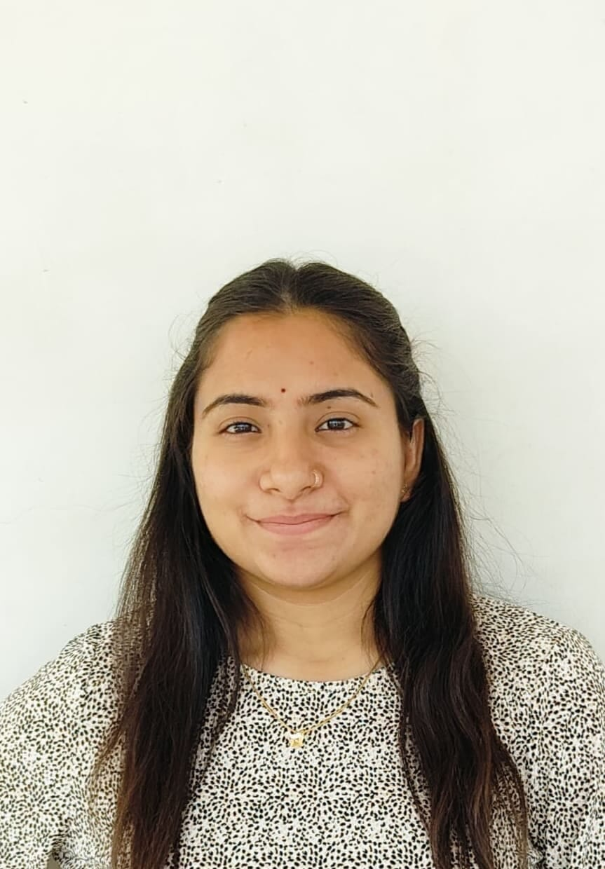

Project Title: AI-Based Dairy Cooperative Supply Chain Optimization Platform
Domain: Economic Development
Student name | Recent passport photo | Email ID | Mobile number [Whatsapp]
Maitree Raulji |  | maitubaaraulji@ gmail.com | 8200063179
Chaudhari Jayesh |  | chaudharijayesh661@gmail.com | 9328903663

Slide 3
Problem statement:
The Challenge:
Dairy cooperatives manage multiple activities such as milk collection, farmer records, payments, demand planning and transportation. When these activities are handled separately, it becomes difficult to get a complete view of daily operations.
Demand and supply mismatch can create surplus, shortage and avoidable wastage. Unplanned transportation routes can increase travel effort and operating cost, while fodder availability and future demand require timely planning.
Cooperative managers therefore need a centralized system that can convert operational information into clear and actionable insights.

Slide 4
Objective:
The Objective:
Build a smart dairy cooperative management platform that can:
Milk Collection Monitoring – Record and monitor daily milk collection activities.
Farmer Management – Maintain farmer and cooperative member information in one place.
Payment Tracking – Track estimated farmer payouts and payment-related information.
Demand & Supply Analysis – Compare milk availability with expected demand and visualize the gap.
Operational Optimization – Support route planning and operational cost awareness.
Predictive Planning – Support demand and fodder forecasting for better future planning.
Decision Support – Provide What-If analysis, Smart Alerts and an AI Assistant.
Dashboard Visualization – Present important KPIs, charts and operational indicators in a simple interface.

Slide 5
Proposed solution:
Smart Milk Collection Management
Digitally record and monitor farmer-wise milk collection, quantity, Fat %, and payment information.
Real-Time Dairy Dashboard
Provide a centralized dashboard to monitor milk collection, demand, supply, transport costs, quality, and cooperative performance.
AI Milk Production Forecasting
Analyze historical milk collection data to forecast upcoming production and help cooperatives plan future milk supply.
Smart Early Warning System
Detect important changes such as declining milk collection, supply-demand gaps, quality variations, and increasing transport costs.
AI Farmer Intelligence
Analyze individual farmer performance using production, quality, consistency, and collection trends.

Slide 6
Proposed solution:
Farmer Performance Score
Generate a transparent 0–100 performance score to identify top-performing and attention-needed farmers.
Personalized Recommendations
Provide data-driven recommendations explaining what was detected, why it matters, and what action can be considered.
Demand & Supply Analysis
Compare available milk supply with expected demand to help identify shortages or excess supply.
Transport Cost Monitoring
Track transportation expenses and highlight unusual increases that may affect cooperative operations.

Slide 7
Technology used:
IBM Bob platform -For designing and orchestrating multi-agent workflows visually
IBM Grainte model - for eg – ibm-granite-3-2-8b – For natural language understanding, reasoning, and personalization
IBM Cloud – It provides the infrastructure to build, deploy, and scale the Nutrition Agent efficiently. IBM Cloud enables a reliable, secure, and scalable environment for deploying the Nutrition Agent.

Slide 8
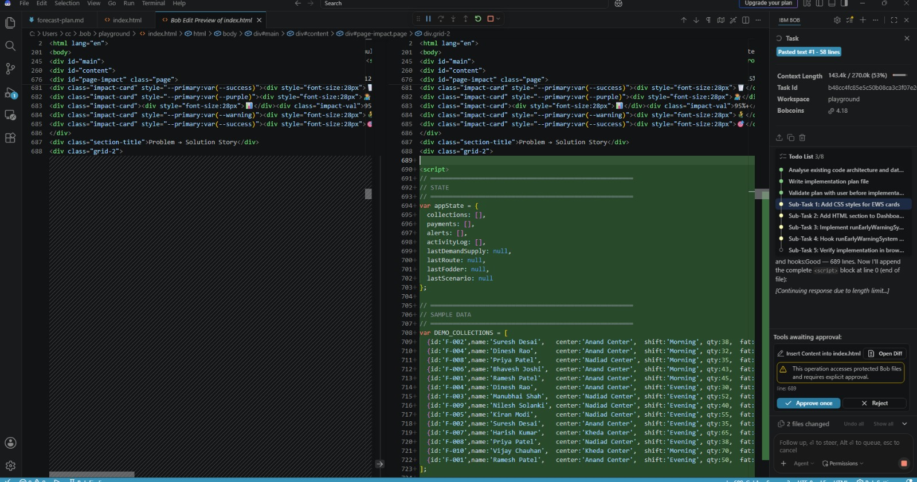
Required Files created using IBM bob:

Slide 9
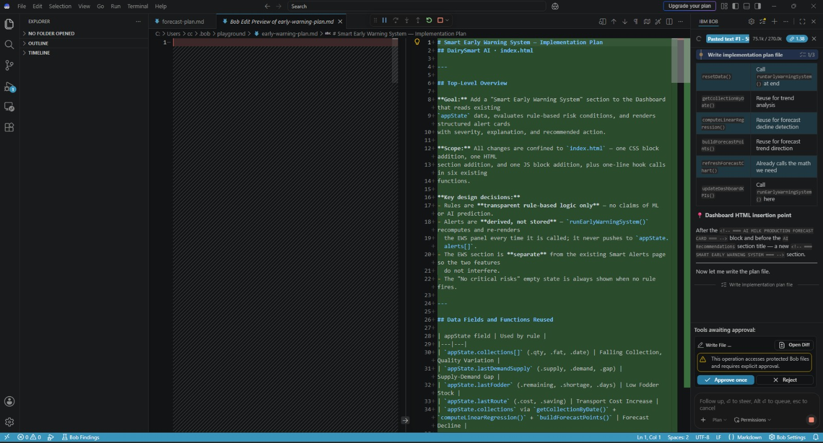
IBM Bob screenshots:

Slide 10
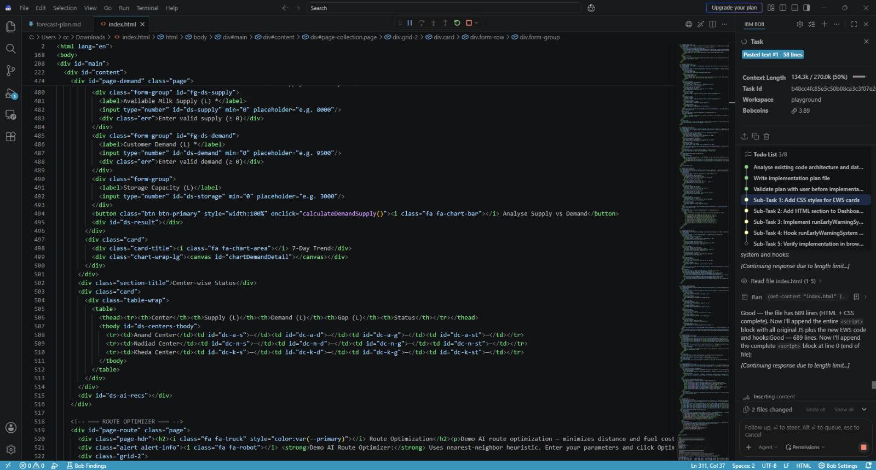
IBM Bob screenshots:

Slide 11
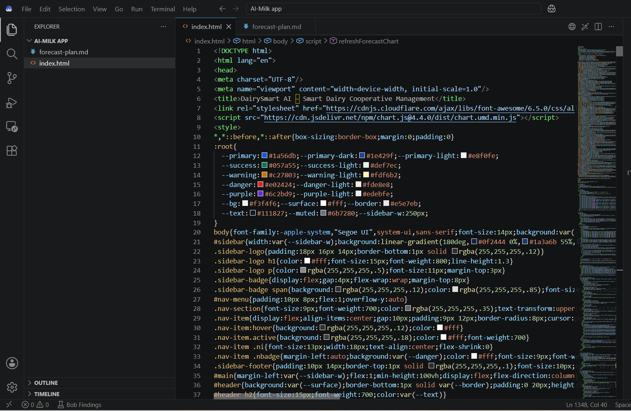
IBM Bob screenshots:

Slide 12
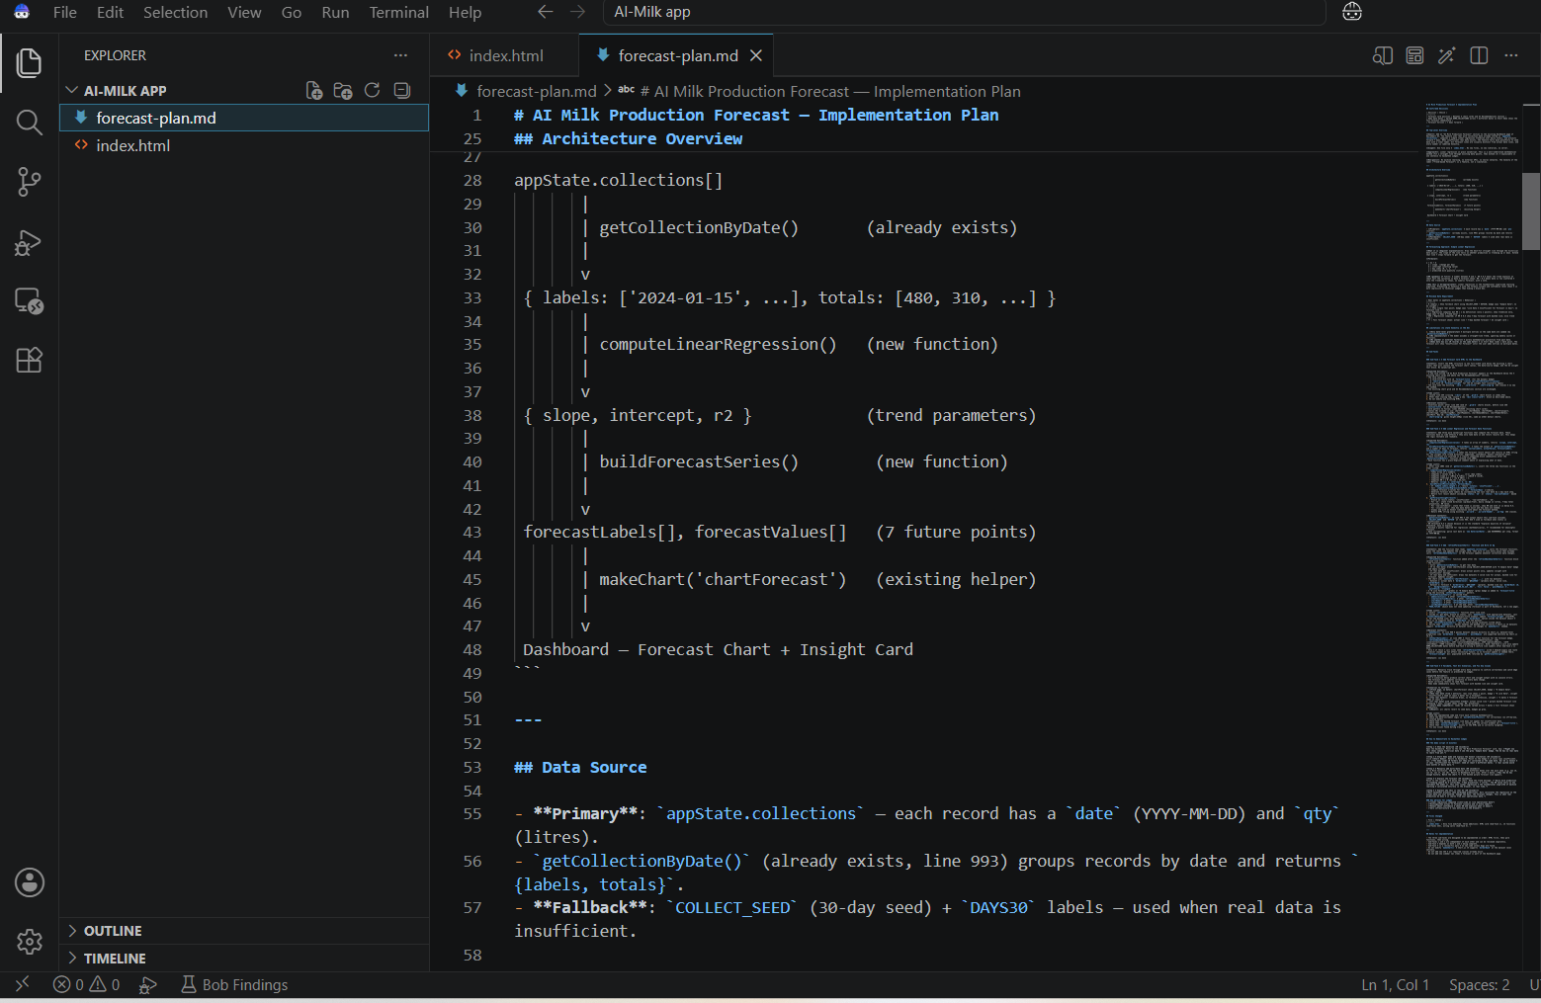
IBM Bob screenshots:

Slide 13
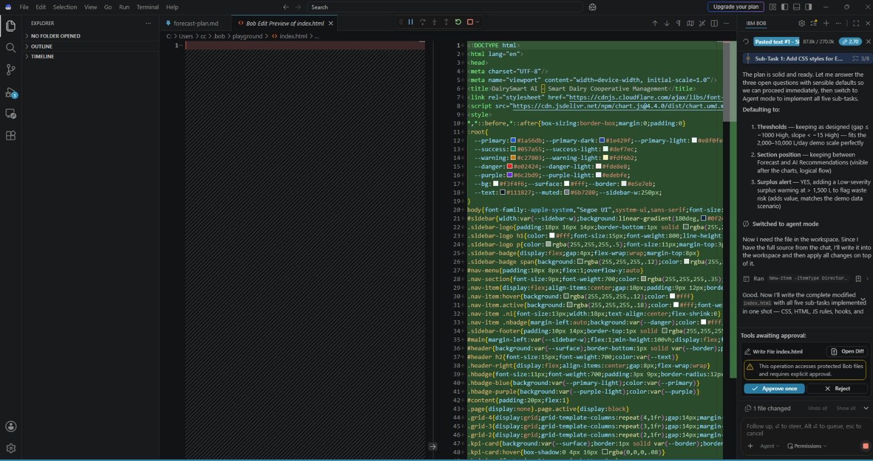
IBM Bob screenshots:

Slide 14
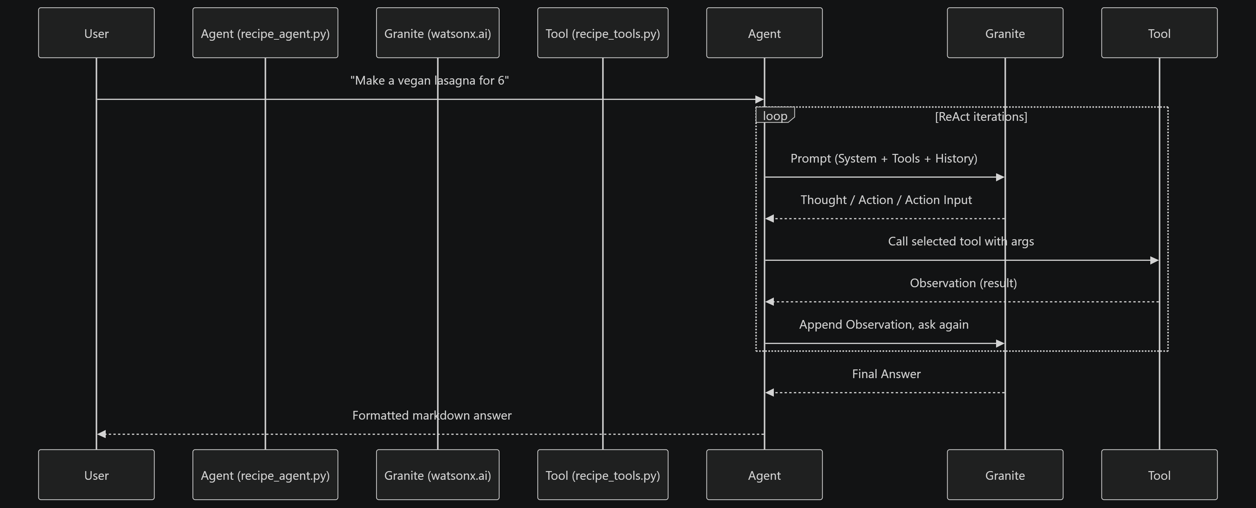
Architecture blueprint for IBM bob:

Slide 15
Role of Agentic AI in the solution:
Agentic AI enables the DailySmart AI platform to function as an intelligent, proactive, and goal-driven dairy management system rather than a simple data-recording application. Using IBM watsonx.ai and IBM Granite models, the system can coordinate specialized AI agents for tasks such as analyzing milk collection data, forecasting production, monitoring demand and supply, detecting early operational risks, analyzing farmer performance, and generating actionable recommendations. This multi-agent approach allows different agents to work collaboratively, where each agent focuses on a specific dairy-management task while contributing to overall decision-making.
Agentic AI also provides context awareness, allowing the system to consider farmer-wise collection history, milk quality, production trends, demand, supply, and operational information to generate relevant insights. It supports real-time adaptation, continuously updating analysis and recommendations whenever new dairy data is entered.

Slide 16
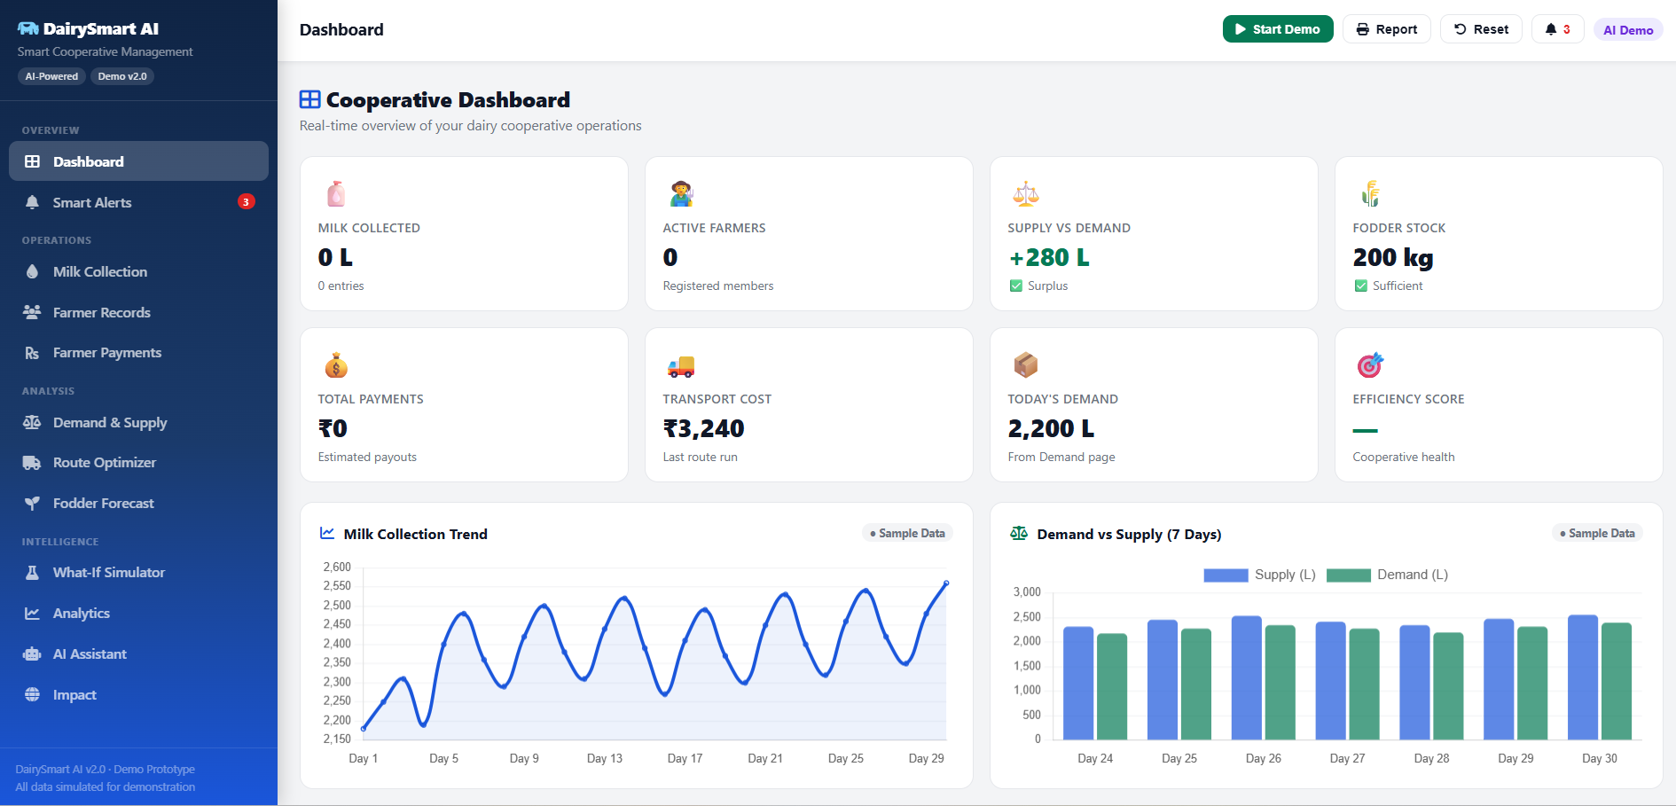
Project Output Screenshot:

Slide 17
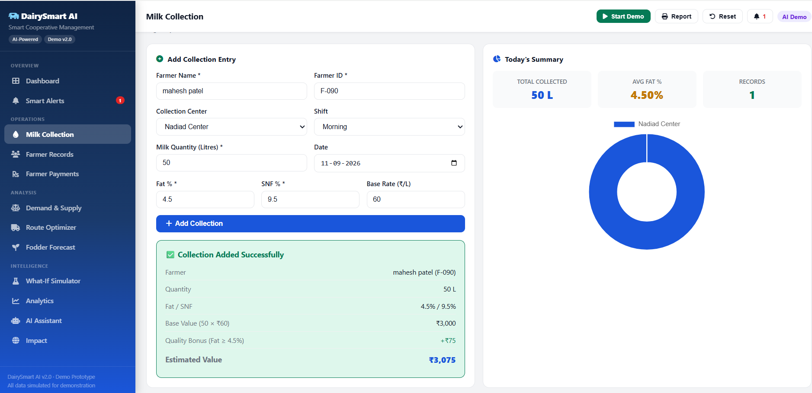
Project Output Screenshot:

Slide 18
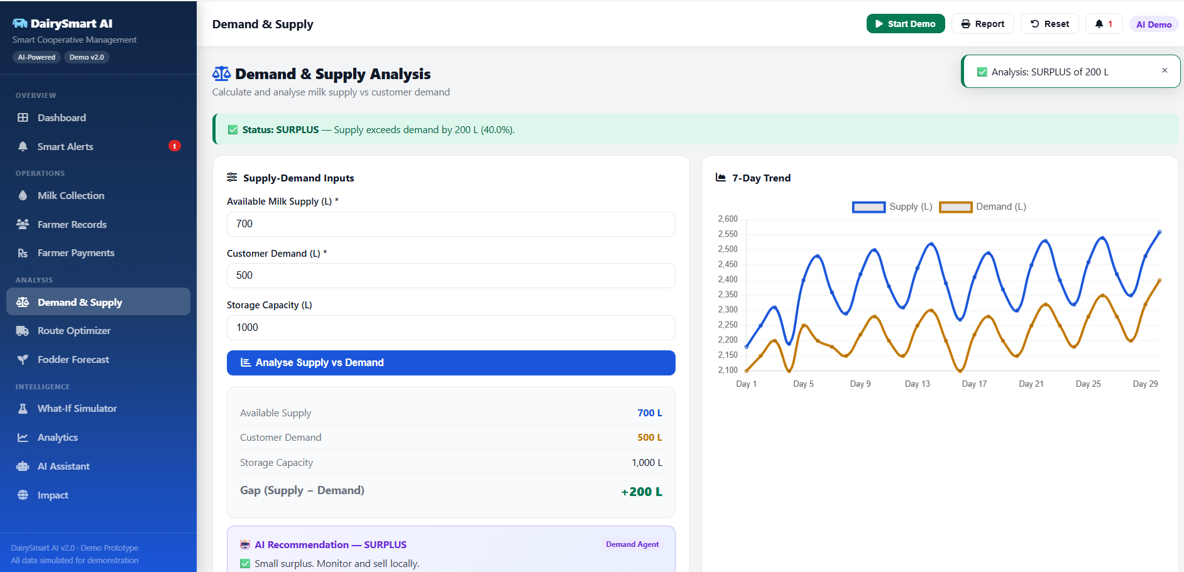
Project Output Screenshot:

Slide 19
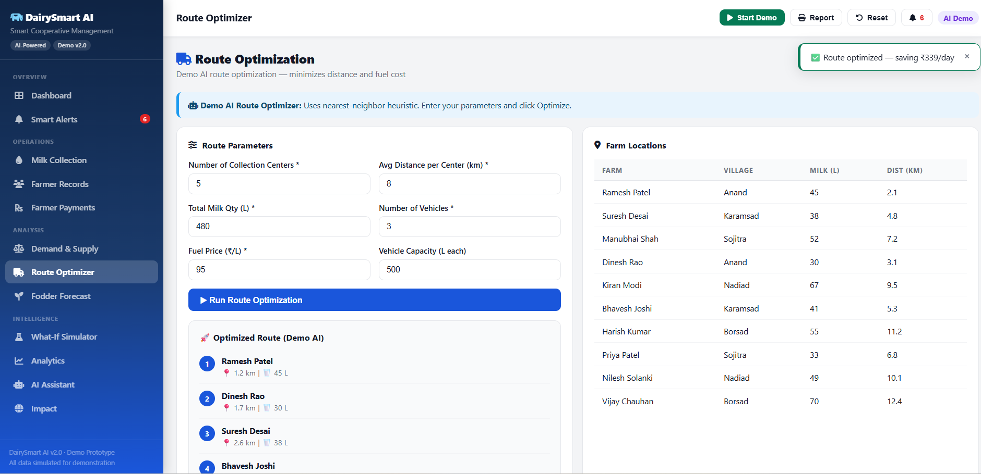
Project Output Screenshot:

Slide 20
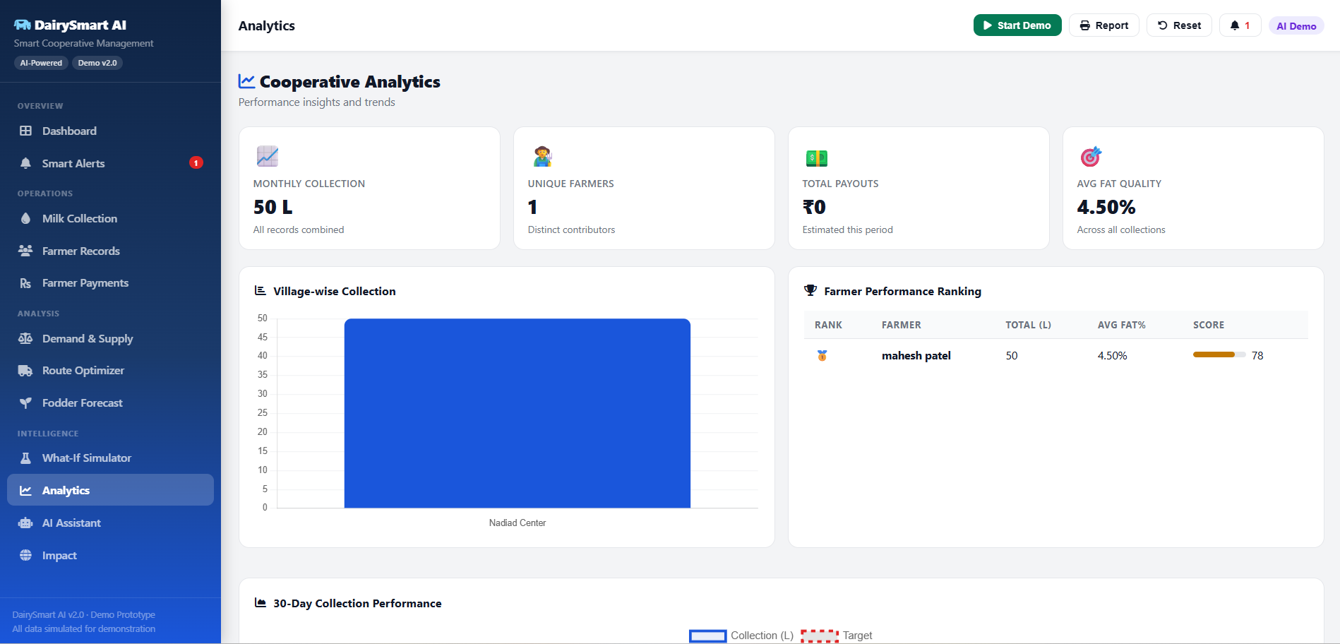
Project Output Screenshot:

Slide 21
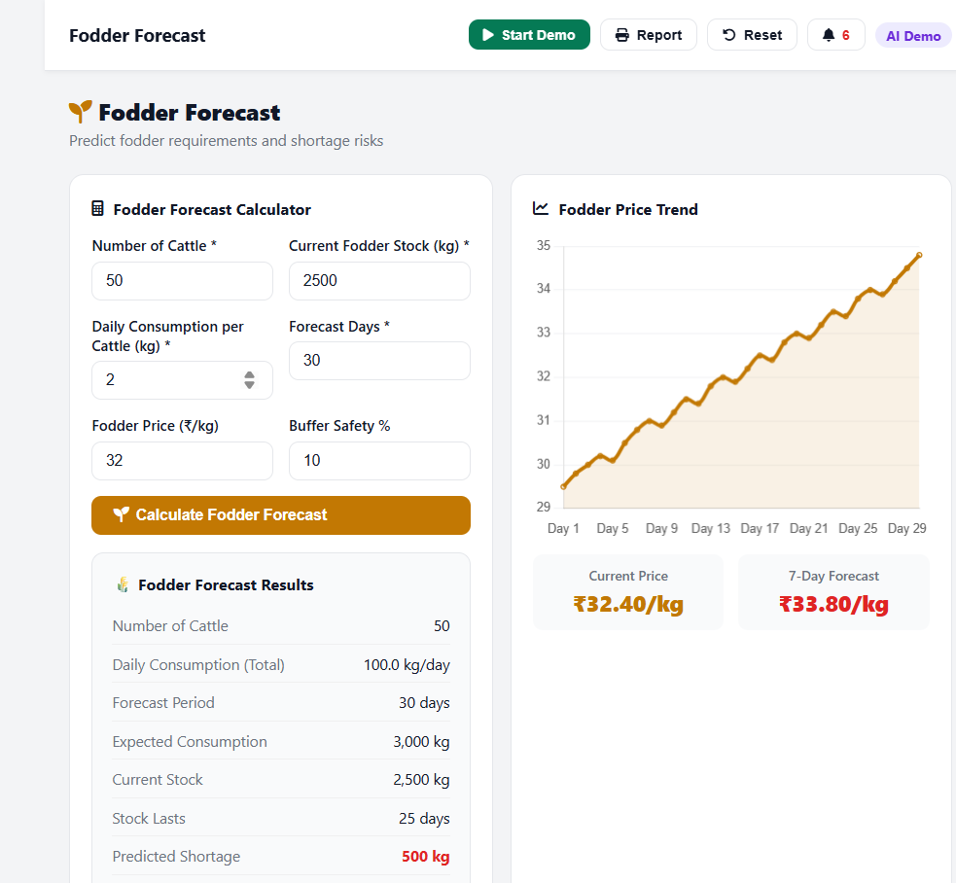
Project Output Screenshot:

Slide 22
The Wow Factor Behind the Project:
Future Milk Prediction
Predicts upcoming milk production using historical collection data.
Early Problem Detection
Identifies falling milk collection, supply-demand gaps, quality changes, and rising transport costs early.
Farmer Intelligence
Gives each farmer a performance score, trend, status, and personalized data-based insights.
Agentic AI with IBM
Uses IBM watsonx.ai + IBM Granite models to support intelligent agents for analysis, forecasting, risk detection, and recommendations.
Smart Decision Making
Converts raw dairy data → insights → predictions → warnings → recommendations → decisions, helping cooperatives manage operations more intelligently.

Slide 23
Novelty and Uniqueness:
The proposed DailySmart AI stands out by combining AI-powered forecasting, early risk detection, farmer intelligence, and smart decision support into one integrated dairy cooperative platform.
Predictive Milk Intelligence – Uses historical milk collection data to forecast future milk production and support better supply planning.
Proactive Early Warning – Detects important changes such as declining collection, supply-demand gaps, quality variations, and rising transport costs before they become major operational issues.
Farmer-Level Intelligence – Goes beyond basic farmer records by analyzing individual performance, collection trends, quality, and generating a transparent performance score.
Agentic AI with IBM – Uses IBM watsonx.ai and IBM Granite models to support intelligent agents that can coordinate analysis, forecasting, risk identification, and recommendations.

Slide 24
Future Scope:
1.AI-Based Milk Demand & Supply Prediction –
The system can be further enhanced using advanced Artificial Intelligence and Machine Learning algorithms to predict milk demand and supply more accurately. By analyzing historical sales, seasonal variations, customer demand, and production patterns, the platform can help dairy cooperatives maintain an optimal balance between milk collection and market demand, reducing wastage and improving profitability.
2. Smart Transportation & Route Optimization –
In the future, the platform can include AI-based route optimization to improve the transportation of milk from farmers and collection centers to dairy processing units and markets. The system can analyze delivery schedules, traffic conditions, distance, and milk quantity to suggest efficient routes, reducing transportation time, operational costs, and the risk of milk spoilage.

Slide 25
Git Hub Link:
Github link URL : https://github.com/maitubaaraulji-cpu/DailySmart-AI
: https://github.com/maitubaaraulji-cpu/DailySmart-AI

Slide 26
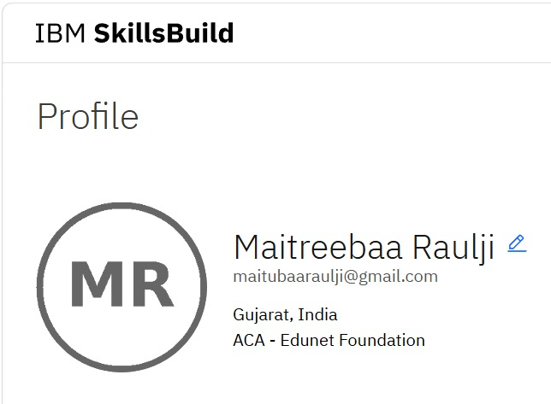
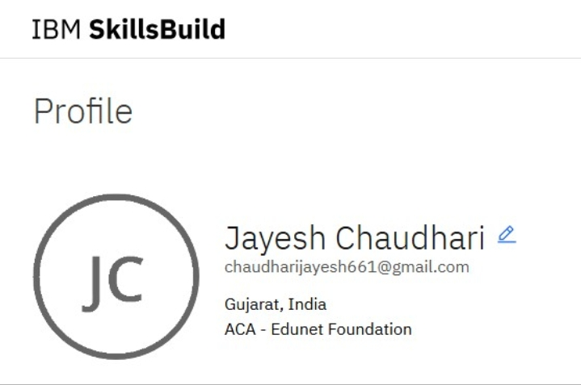
Skills build profile screen shot:
IBM Skills Build Profile
IBM Skills Build Profile

Slide 27
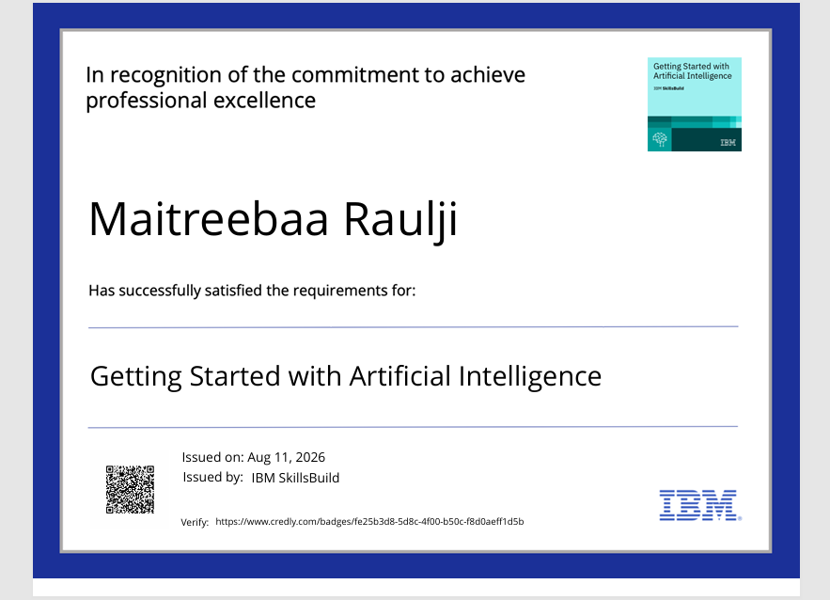
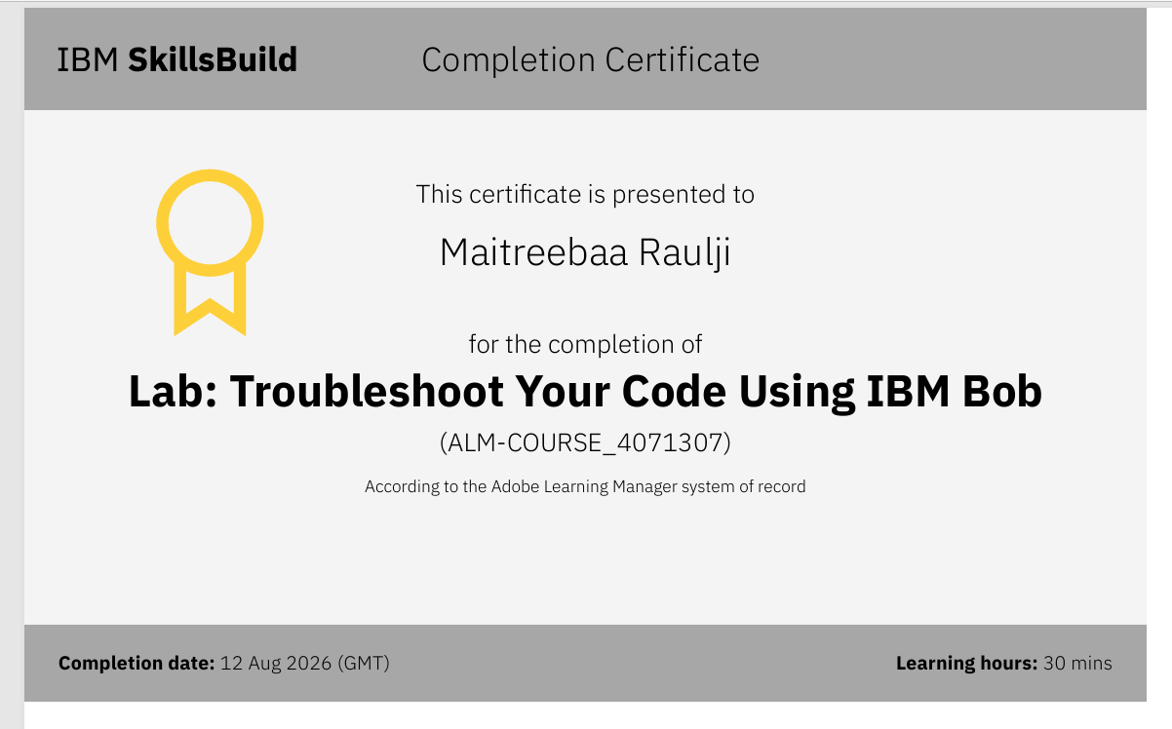
Certificates Earned:
1. Credly Certificate: (Getting Started with Artificial Intelligence)
2. IBM BOB Certificate

Slide 28
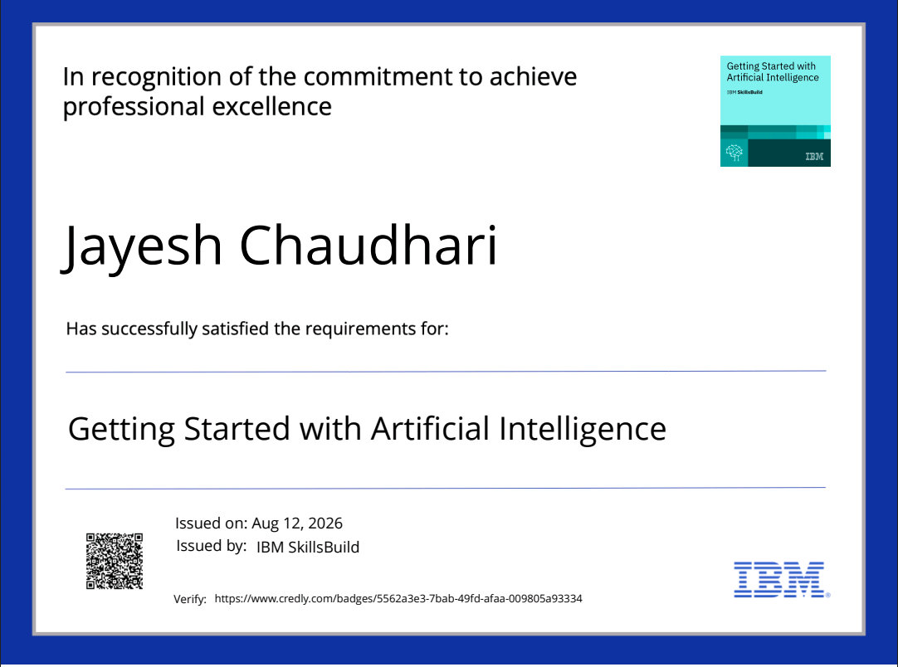
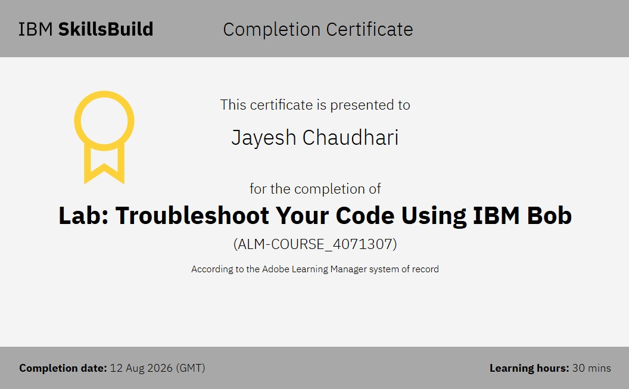
Certificates Earned:
1. Credly Certificate: (Getting Started with Artificial Intelligence)
2. IBM BOB Certificate

Slide 29
Thank you

